Slide 1
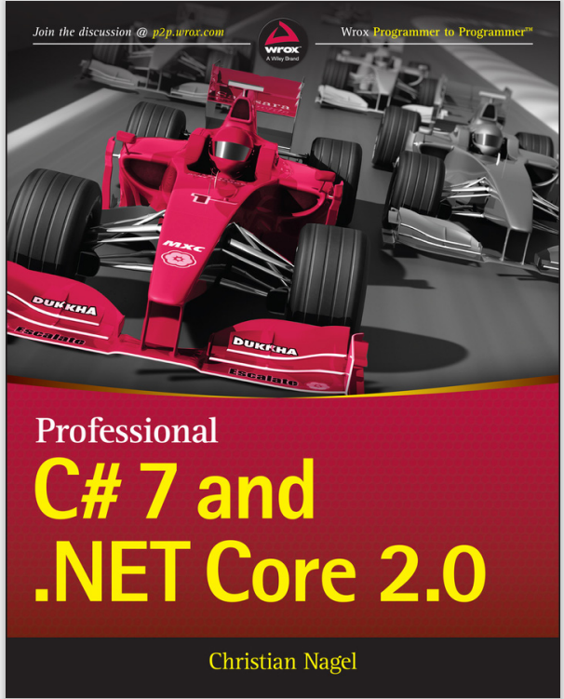
Programming
Chapter 5
Conditional Statements
[Book name]

Slide 2
topics
if statement
if … else statement
if … else … if statement
Compound statement
Increase / Decrease statement
Switch statement

Slide 3
The if statement
The most simple conditional statement
Enables you to test for a condition
Branch to different block in the code depending on the result
Syntax
if (condition)
{
statements;
}

Slide 4
Condition and statement
The condition can be
Boolean variable
Boolean logical expression
Comparison expression
The condition cannot be integer variable(like in C/C++)
The statement can be
Single statement ending with a semicolon
Blocked enclosed in curly braces

Slide 5
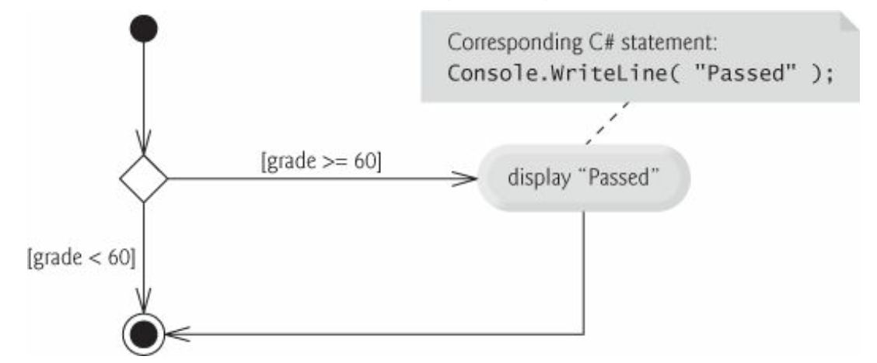
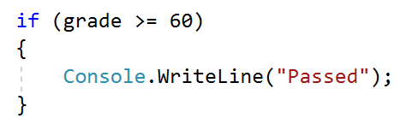
if single-selection statement

Slide 6
The if-else statement
More complex and useful conditional statement
Executes one branch if the condition is true, and another if it is false
The simplest form of an if-else statement
if ( if (condition)
{
// Code to execute if the condition is true
}
else
{
// Code to execute if the condition is false
}

Slide 7
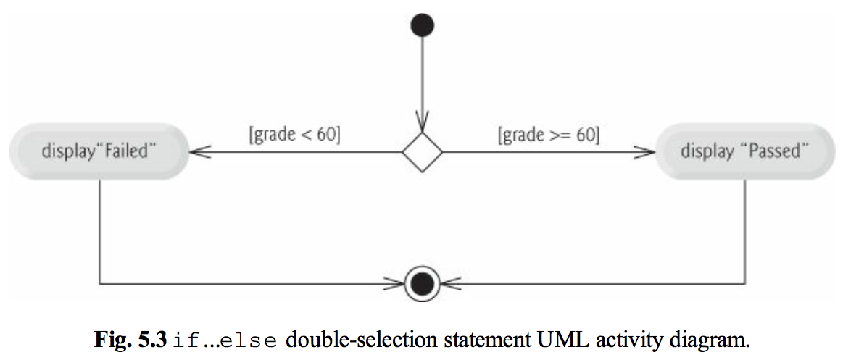
if…else Double-selection statement

Slide 8
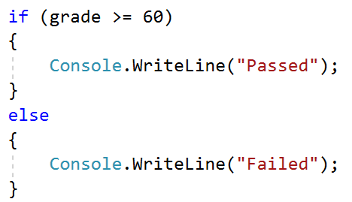
if…else Double-selection statement

Slide 9
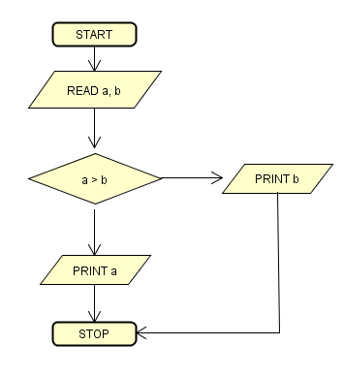
if…else Double-selection statement
Exercise: Write a program to find max between a, b and display max number

Slide 10
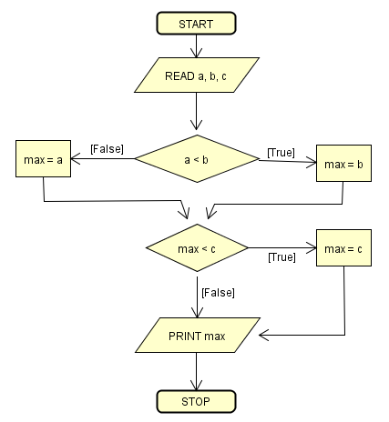
if…else Double-selection statement
Exercise: Write a program to find max among a, b and c

Slide 11
Conditional operator (?:)
A ternary operator, can be used in place of if…else
(conditional expression ? true expression : false expression)
e.g., gradeStr = (grade >= 60 ? “Passed” : “Failed”);
E.g., max = a > b ? a : b;
max = max > c ? max : c;
Exercise: Rewrite program find max with conditional operator

Slide 12
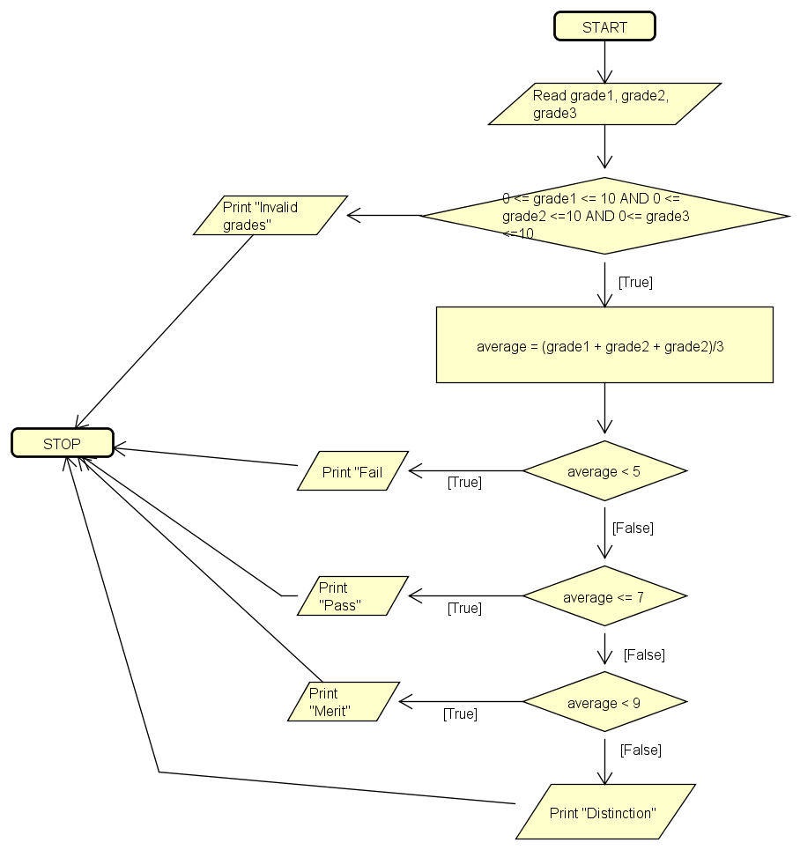
if…else if ladder
Instead of nesting many levels of if…else, we could use if…else if ladder

Slide 13
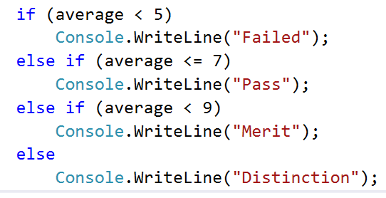
if…else if ladder
Instead of nesting many levels of if…else, we could use if…else if ladder
Exercise: Write program according to the flowchart in previous slide
Notes:
Nhập vào điểm asm1 và asm2. Tính trung bình cộng 2 điểm. Nếu trung bình cộng <60 -> Failed
TBC trong khoảng 60-80: Điểm P
Trong khoảng 80-90: Điểm M
Trên 90: Điểm D

Slide 14
Nested if Statements
Nested if statements are if statements that are placed inside another if statement.
They allow you to test multiple conditions and execute different code depending on the combination of those conditions.
Syntax:
if (condition1)
{
// code block to execute if condition1 is true
if (condition2)
{
// code block to execute if both condition1 and condition2 are true
}
}

Slide 15
Nested if – Good practices
Always use {…} blocks to avoid ambiguity
Even when a single statement follows
Avoid using more than three levels of nested if statements
Put the case you normally expect to process first
Then write the unusual cases
Arrange the code to make it more readable

Slide 16
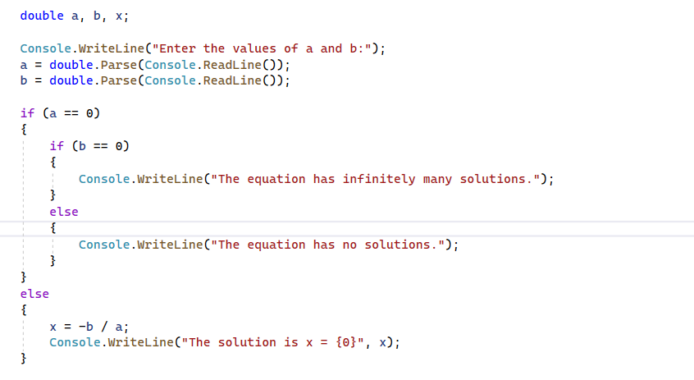
Nested if - Example

Slide 17
Problem: Back in 30 Minutes
Write a program that reads hours and minutes from the console and calculates the time after 30 minutes
The hours and the minutes come on separate lines
Example:
1
46
0
01
23
59
2:16
0:31
0:29
11
08
12
49
11
32
11:38
13:19
12:02

Slide 18
Solution: Back in 30 Minutes
int hours = int.Parse(Console.ReadLine());
int minutes = int.Parse(Console.ReadLine()) + 30;
if (minutes > 59) {
hours += 1;
minutes -= 60;
}
if (hours > 23) {
hours = 0;
}
Console.WriteLine("{0}:{1:D2}", hours, minutes);

Slide 19
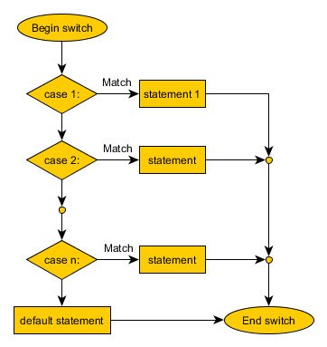
General form of Switch statement

Slide 20
How switch –case works
1. The expression is evaluated
2. When one of the constraints specified in a case label is equal to the expression
The statement that corresponds to that case is executed
3. If no case is equal to the expression
If there is default case, it is executed
Otherwise the control is transferred to the end point of the switch statement

Slide 21
General form of Switch statement
switch(expression){
case item1:
//one or more statements;
break;
case item2:
//one or more statements;
break;
case itemn:
//one or more statements;
break;
default:
//one or more statements;
break;
}

Slide 22
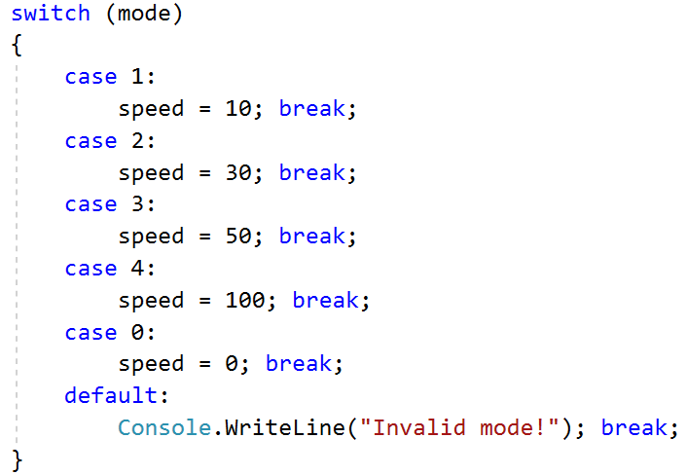

General form of Switch statement

Slide 23
Using switch – Rules
Variable types like string, enum and integral types can be used for switch expression
The value null is permitted as a case label constant
The keyword break exits the switch statement
“No fall through” rule
You are obligated to use break after each case
Multiple labels that correspond to the same statement are permitted

Slide 24
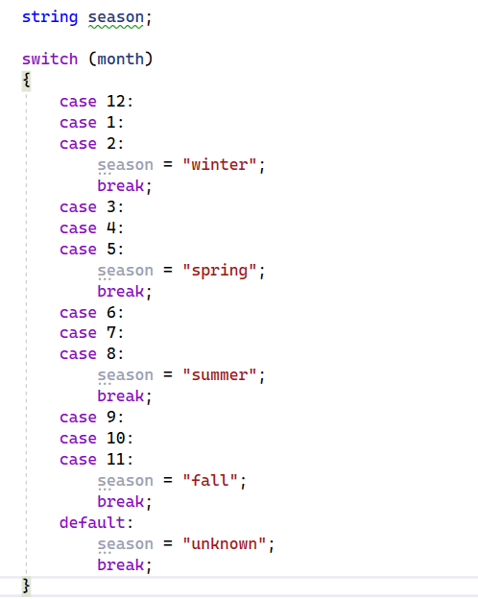
Multiple labels - Example
Multiple labels allow matching several
cases and executing the same statement
in more than one case

Slide 25
Using switch- Good practices
There must be a separate case for every normal situation
Put the normal case first
Put the most frequently executed cases first and the least frequently executed last
Order cases alphabetically or numerically
In default use case that cannot be reached under normal circumstances

Slide 26

Problem: Foreign Languages
By given country print its typical language:
English -> England, USA
Spanish -> Spain, Argentina, Mexico
other -> unknown
England
English
Spain
Spanish

Slide 27
Solution: Foreign Languages
switch (country)
{
case "USA":
case "England": Console.WriteLine("English"); break;
case "Spain":
case "Argentina":
case "Mexico": Console.WriteLine("Spanish"); break;
default: Console.WriteLine("unknown"); break;
}

Slide 28
Activity: Arithmetic operators
Make a program to
Ask user to input two numbers
Ask user to input one of these arithmetic operators represented by character (‘+’, ‘-’, ‘*’, ‘/’)
Display “invalid operator” if user inputs the wrong character
Else, display the corresponding result

Slide 29
Homework: vowels
Make a program to
Ask user to input a character
Display an error message if user inputs a non alphabet character (check with ASCII e.g., ‘a’ < c <‘z’ for lower case characters)
If the character is alphabet, check if it is a vowel (‘a’, ‘e’, ‘i’, ‘o’, ‘u’) or a consonant
Display the result

Slide 30
Sumary
Comparison and logical operators are used to compose logical conditions
The conditional statement if and if-else conditionally execution of blocks of code
Constantly used in computer programming
Conditional statements can be nested
The switch statement easily and elegantly checks an expression for a sequence of values

